Slide 1
Financial Accounting & Reporting
By CA. Kajal Kumar Singh

Slide 2
Syllabus
Analysis of Financial Statements
Comparative Statements
Ratio Analysis
Liquidity
Activity
Profitability
Solvency
Market Evaluating Ratios
Du-Pont Analysis
Common Size Statements
User
Limitation
Notes:
Comparative- Horizontal & Vertical

Slide 3
What is Financial Statements ?

Slide 4
Financial Statements
Balance Sheet
Profit and Loss Accounts
Cash Flow Statement
Equity Change
Notes to Accounts

Slide 5

Balance Sheet
The Statement of Financial position Summarizes an organizations or individuals Assets, equity and liabilities at a specific point in time.
Uses of Resources = Sources of Resources
Assets
Liability + Shareholders Equity

Slide 6
Share Capital
Authorised Capital is the maximum amount of capital which a company is authorised to issue by its Memorandum of Association.
Issued Capital is the part of Authorised capital which is actually issued for subscription to the public.
Subscribed capital is the part of issued capital which is actually subscribed by the public
Equity share carries right to vote and capital appreciation
Preferential share is the type of share which have preferential right over equity share w.r.t payment of dividend and upon liquidation
Calls in arrear is the unpaid amount on the shares bought by a shareholder.
Share Forfeiture – If the shareholder fails to pay the call money in stipulated time ,his shares can be forfeited by the company.
Authorised Capital
Issued Capital
Unissued Capital
Subscribed Capital
Unsubscribed Capital

Slide 7
Liabilities
DEBENTURES/BOND : A debenture is an instrument of debt executed by the company acknowledging its obligation to repay the sum at a specified rate and also carrying an interest. Debenture holders don’t have right to vote Annual General Meetings.
TERM LOAN : A loan from a bank for a specific amount that has a specified repayment schedule and an interest.
Bank Overdraft
Short term borrowings : period less than one year.
Commercial paper : Commercial paper is an unsecured promissory note with a fixed maturity of 1 to 270 days
CURRENT LIABILITIES & PROVISIONS:
Current Liabilities : A company's debt or obligation that are due within one year.
Provisions : It is the liability of uncertain timing and uncertain amount.
Sundry Creditor : A company or individual who owed money.

Slide 8
Assets
FIXED ASSET : A long term Tangible or Intangible asset held for business use and not expected to be converted to cash in current or upcoming fiscal year.
INVESTMENTS: The purchase of a financial product or other item of value with an expectation of favourable future returns. (E.g. Govt Bonds, Securities, investment in Subsidiaries/ JV)
CURRENT ASSET, LOANS AND ADVANCES:
Current Asset : Asset which can either be converted in cash or used to pay current liability within 12 months.
Inventory: It is the total amount of goods or material in a store or factory.
Sundry Debtor/ Trade receivables: A company or individual who owes money
Loan & advances : It is the loans to the body corporate and employees

Slide 9
PROFIT AND LOSS ACCOUNT
Revenue
Other Income
Income
 | PARTICULARS
1 | INCOME
2 | EXPENDITURE
3 | LESS : PROVISION FOR TAXATION
4 | PROFIT AFTER TAX & BEFORE STATUTORY APPROPRIATIONS
5 | STATUTORY APPROPRIATIONS
6 | DISTRIBUTABLE PROFIT
7 | APPROPRIATIONS
8 | BALANCE CARRIED TO BALANCE SHEET
Profit and Loss Accounts
Cost of Power Purchased
Cost of Fuel Consumed
Employee Benefits Expense
Depreciation and Amortisation Expense
Finance Costs
Other Expenses
Notes:
Stat Appro: NBFC, Reserve

Slide 10
Cash Flow Statements
Cash flows of an enterprise is useful in providing users of financial statements with a basis to assess the ability of the enterprise to generate cash and cash equivalents and the needs of the enterprise to utilise those cash flows.
CASH FLOW during a year comprises of the following activities.
Operating Activities
1.Sales of good
2.Fees
3.Commissions
Investing Activities
1.Fixed assets
2.R&D
3.Loans
Financing Activities
1.Issue of shares
2.Debentures

Slide 11
Cash Flow Statements
Profit Before Tax
Less Non-operating income (e.g. Interest income, profit on sale of assets)
Add Interest expense
Add Depreciation
Less Other cash adjustments (e.g. Unrealized foreign exchange loss)
= Operating Profit before Working Capital Changes
Less Increase in Debtors
Less Increase in Inventory
Less Increase in other current assets (e.g. Loans and Advances)
Add Increase in Creditors
Add Increase in other Current liabilities and Provisions
= Cash generated from Operations
Less Taxes
= Net Cash from Operating Activities

Slide 12
Cash Flow Statements
Investing Activities
Purchase of Fixed Assets (negative because it is cash outgo)
Add Purchase of Long-term investments
Less Proceeds from Sale of Fixed Assets or Investments (if any)
Add Interest and Dividend Income
= Net Cash used in Investing Activities
Financing Activities
Proceeds from issue of share capital
Add Proceeds from raising fresh loans
Less Repayment of existing loans
Less Interest expense
Less Dividend paid
= Net Cash Generated from Financing Activities
Opening Balance: Cash and Cash Equivalents
Add Net Cash from Operating Activities
Less Net Cash used in Investing Activities
Add Net Cash Generated from Financing Activities
= Closing Balance: Cash and Cash Equivalents

Slide 13
FINANCIAL STATEMENT ANALYSIS

Slide 14
Financial Statement Analysis
1. Comparative Statements
2. Common Size Percentages
3. Trend Analysis
4. Ratios Analysis.

Slide 15
Comparative Statements
Financial statements presenting financial data for two or more periods are called comparative statements. Comparative financial statements usually give similar reports for the current period and for one or more preceding periods. Comparative statements are considerably more significant than are single-year statements.
Horizontal analysis: Horizontal analysis spotlights trends and establishes relationships between items that appear on the same row of a comparative statement. Horizontal analysis discloses changes on items in financial statements over time.
Each item (such as sales) on a row for one fiscal period is compared with the same item in a different period.
Horizontal analysis can be carried out in terms of changes in amounts, in percentages of change, or in a ratio format.
Horizontal analysis may be conducted for balance sheet, income statement, schedules of current and fixed assets and statement of retained earnings
Amount of the item in comparison year – Amount of the item in base year x100
Amount of the item in base year

Slide 16
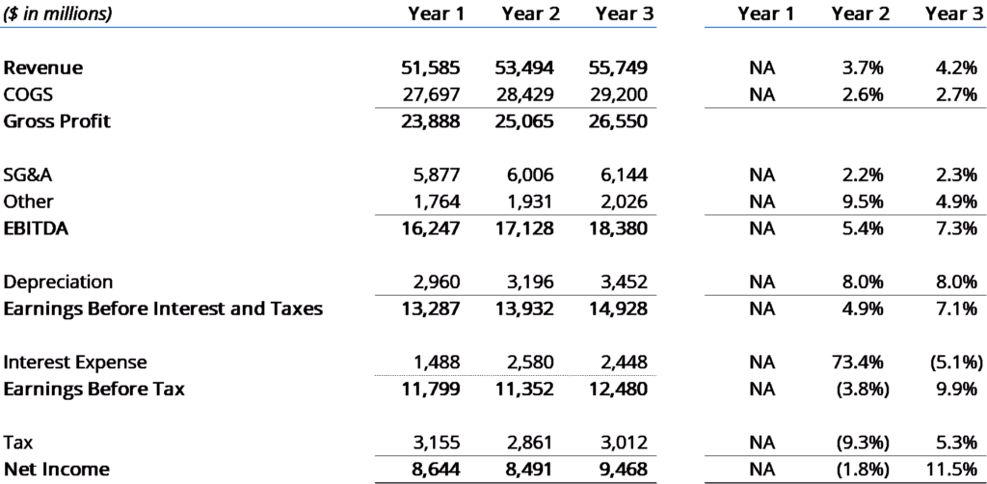
Horizontal Analysis- Example

Slide 17
Comparative Statements
Vertical analysis: Vertical analysis involves the conversion of items appearing in financial statement columns into terms of percentages of a base figure to show the relative significance of the items and to facilitate comparison.
On the balance sheet, individual assets can be expressed in terms of their relationship to total assets. Liabilities and shareholders’ equity accounts can be expressed in terms of their relationship to the total of liabilities and shareholders’ equity.
On the income statement, each item is stated as a percentage of sales.
In a vertical analysis the percentage is computed by using the following formula:
Amounts of Individual Items x100
Amount of Base

Slide 18
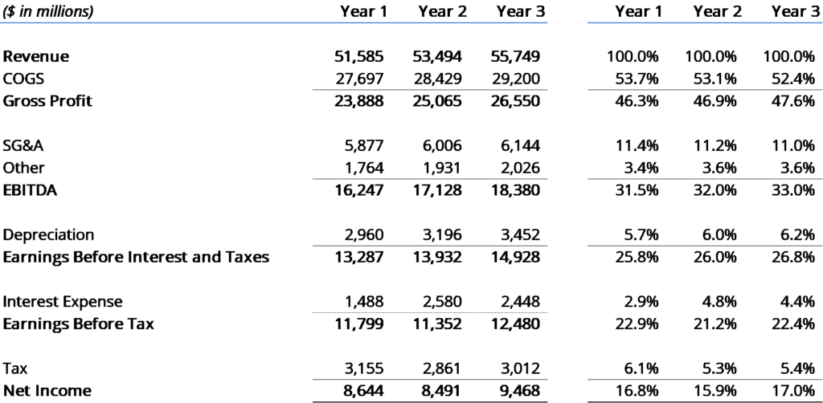
Vertical Analysis- Example

Slide 19
Common-Size Financial Statements
Common size statements are financial statements expressed in percentage form.
Each item in the common-size statement has a common basis for comparison, for example, total assets, net sales.
A common size income statement would consider the sales figure as 100%. Every expense in the income statement will then be expressed as a percentage of the sales figure.
Similarly in common size balance sheet the total assets figure is considered to be 100%. Everything else is expressed as a percentage of the same.
On comparative, common-size statement, the comparisons demonstrate the changing or stable relationships within groups of assets, liabilities, revenues, expenses, and other financial statement categories.
The analysts look step by step at the financial statements and compare them with other companies. This helps them understand how the company has a different asset structure and cost structure in comparison to its competitors and whether it is favorable or unfavorable for the organization.

Slide 20
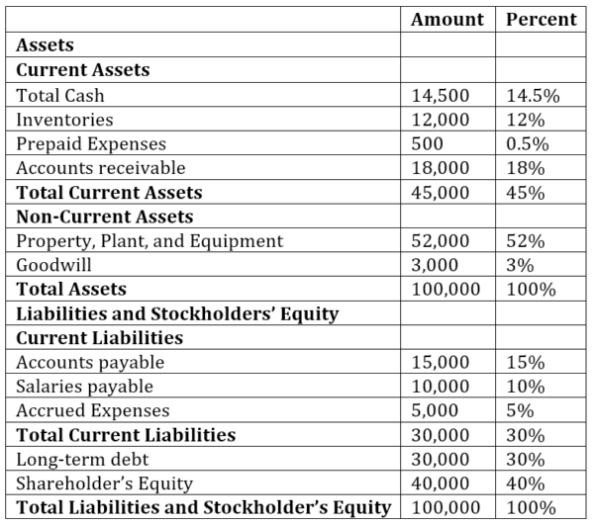
Balance Sheet Common Size Analysis

Slide 21
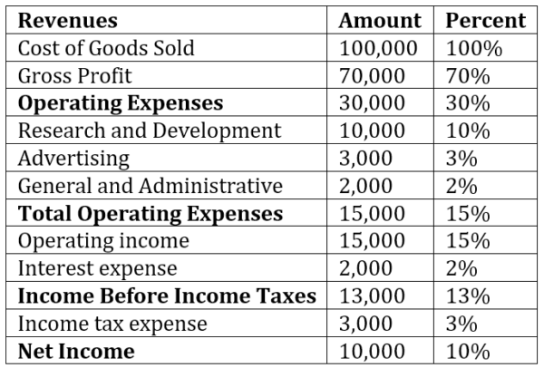
Income Statement Common Size Analysis

Slide 22
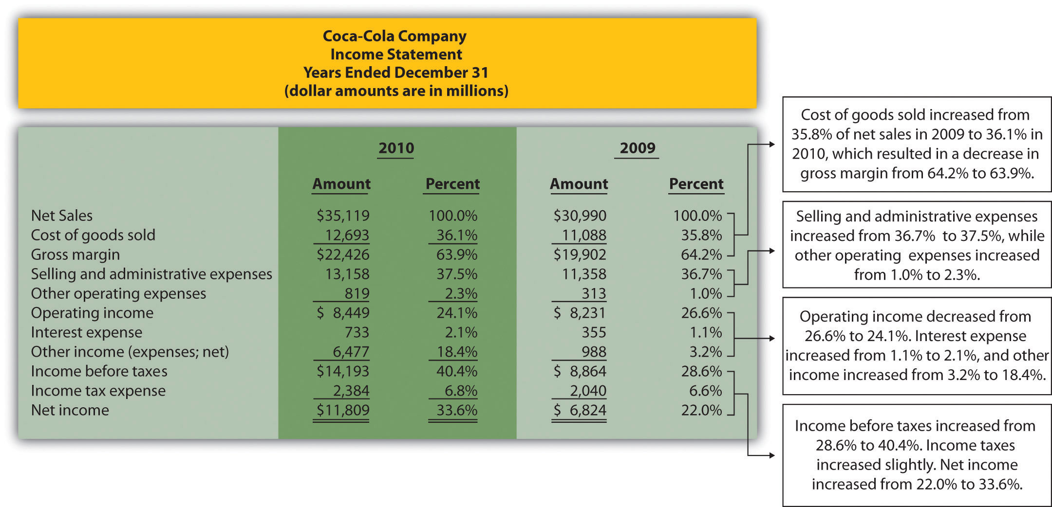
Common-Size Income Statement Analysis

Slide 23
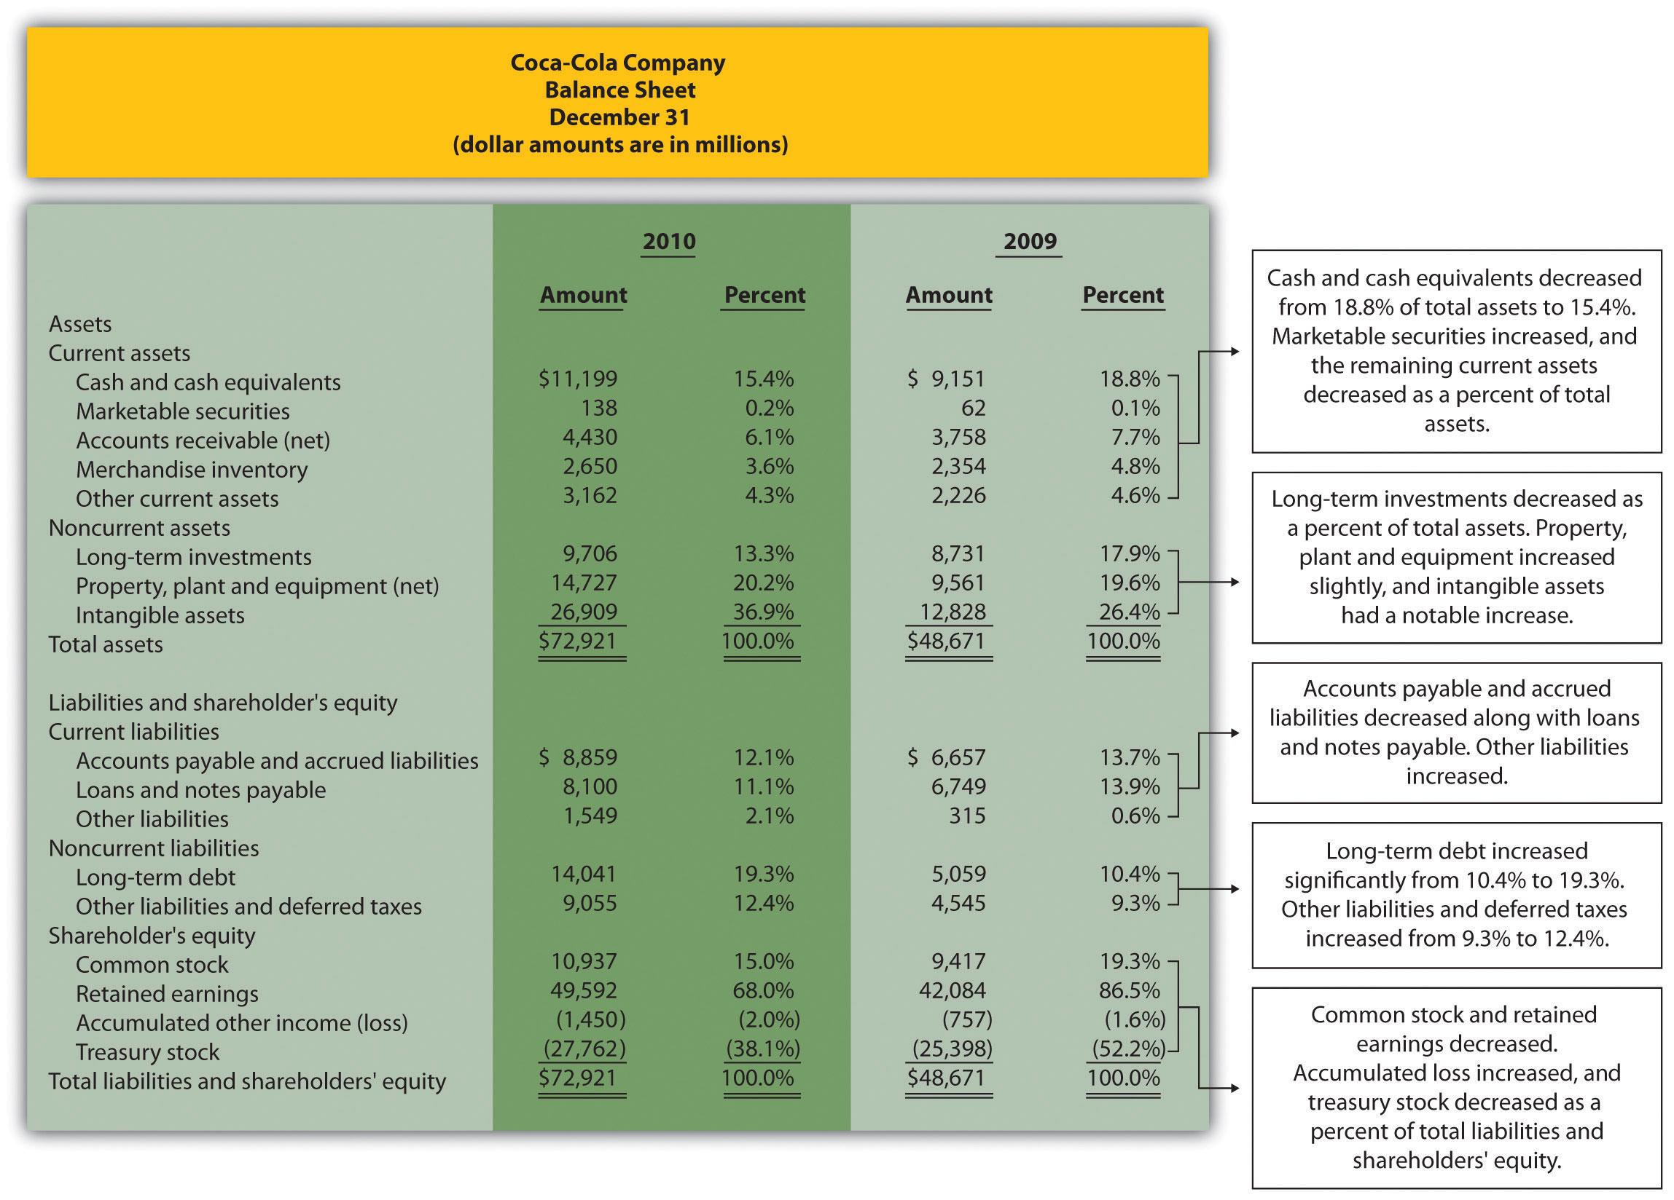
Common-Size Balance Sheet Analysis

Slide 24
Trend Analysis
Trend analysis is analysis which entails comparison with the company’s own past performance.
The problem in conducting this analysis is that all the numbers keep changing and there is no fixed base.
With the help of common size statements, the base gets fixed at 100% and all the numbers can be compared across years.
Figures generated in subsequent years are expressed as percentages of base-year numbers.
Trend analysis indicates in which direction a company is headed.
A company can figure out whether its advertising costs have gone up compared to last year and if so, why?

Slide 25
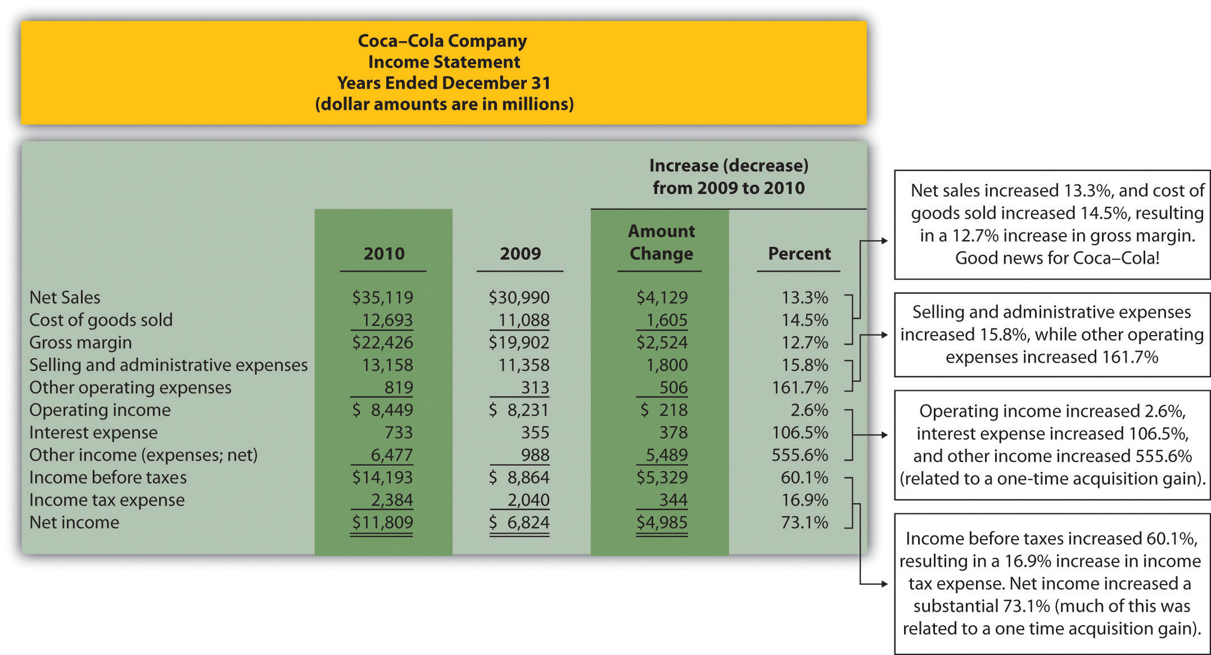
Trend Analysis

Slide 26
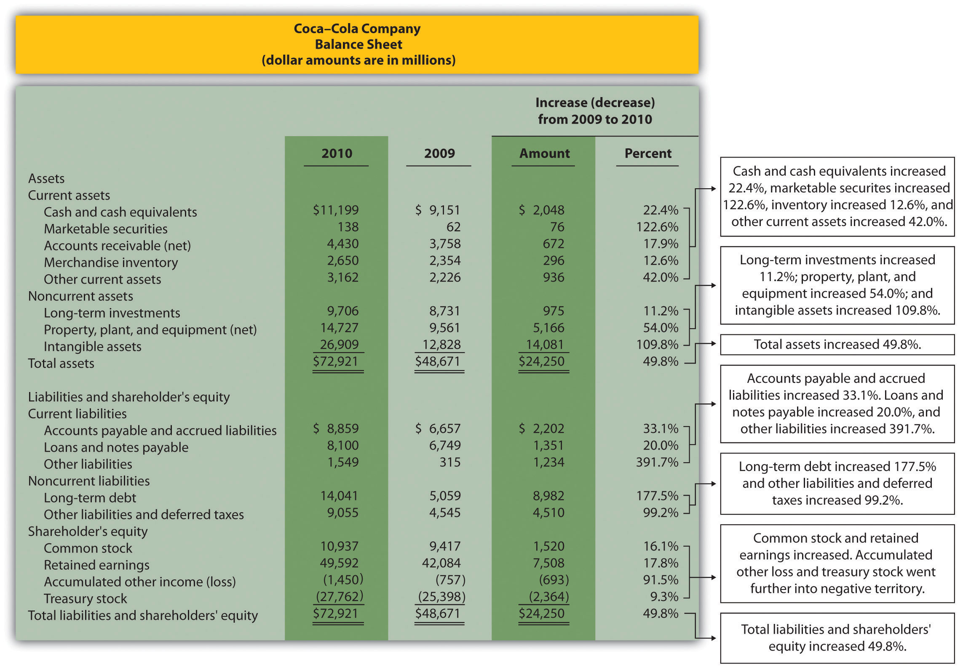
Trend Analysis

Slide 27
Ratio Analysis
A ratio is an expression of a mathematical relationship between one quantity and another.
If a ratio is to have any utility, the element which constitutes the ratio must express a meaningful relationship.
Ratio analysis can disclose relationships which reveal conditions and trends that often cannot be noted by inspection of the individual components of the ratio.
Typical ratios are fractions usually expressed in percent or times.

Slide 28
USERS OF FINANCIAL STATEMENTS ANALYSIS
Creditors: Creditors are concerned with the company’s ability to pay interest and principal when due and are concerned with the company’s cash flow ability.
Shareholders: Shareholders provide company with the much needed capital and are interested to know company’s ability to pay dividend, and growth of dividends and maximize shareholders wealth.
Prospective Investors: Financial statement analysis is used by the prospective investors to evaluate the attractiveness of the investment in the business.
Management: Management uses financial statement analysis to analysis the efficiency of operations and make important business decisions. For example- whether or not to continue or discontinue part of its business, to make or buy certain material, or to acquire or rent/lease certain equipment.
Regulatory Authorities: For publicly traded companies, financial statements are analyzed to ensure compliance to various rules and regulations.

Slide 29
ATTRIBUTES OF FINANCIAL STATEMENTS ANALYSIS
Objectivity: Results of financial statement analysis should be analyzed objectively to reduce the possibility of any behavioral bias to minimum.
Precision and Brevity: Financial statement analysis should done with precision and should provide relevant information in concise form.
Understandability: Information provided by financial statement analysis should be presented in such a way that the analysis fosters understandability.
Relevance: Analysis of financial statement should be relevant to the purpose of the analysis. Financial statements used in analysis should be timely and should have a predictive value.
Reliability: The information derived from the analysis of financial statement must be free of material error and bias and should provide full and fair disclosure of the financial performance and other relevant information.

Slide 30
LIMITATION OF FINANCIAL STATEMENTS ANALYSIS
Comparing companies with different fiscal year end can be difficult.
Comparing companies with different accounting methods (for example Inventory LIFO vs. FIFPO, depreciation method) can be difficult.
Estimates are as accurate as input and depends on the integrity of the input data.
Takes into account only quantitative factors and ignore qualitative factors such as efficiency, loyalty and honesty of the human resource.
Explanation of the results of the analysis involves human decision.
Data based on historical events which may not hold in future.

Slide 31
